Slide 1
INTERNSHIP PROJECT / FULL STACK DEVELOPMENT
VOLT
GYM
Website & Enquiry Management System
A responsive digital experience for gym discovery, membership information,
member feedback and staff-side enquiry management.
INTERNSHIP COMPANY
DEVELOPED BY
ASTGEN SOFTWARES LLP
Aditya Shukla · 0614CS231004
Dileep Rathore · 0614CS231016
PROJECT OVERVIEW
01 — 25
4th Year · Computer Science Department
Pt. Devprabhakar Shastri College of Technology
GUIDE Ajay Prajapati / HOD Santosh Patel

Slide 2

01 / PROJECT OVERVIEW
A digital front door for a neighbourhood gym
Volt Gym brings the gym’s identity, training options and membership plans together in one responsive website.
The same experience also supports structured visitor enquiries and star-rated reviews, with a private admin inbox for staff.
01
02
03
Discover
Enquire
Manage
PUBLIC WEBSITE → PHP API → MYSQL → ADMIN INBOX
VOLT GYM / ASTGEN SOFTWARES LLP
02 / 25

Slide 3
02 / PROBLEM STATEMENT
Why this project exists
A gym website should answer the questions people have before they visit.
INFORMATION GAP
CONTACT FRICTION
FEEDBACK VISIBILITY
Visitors need clear details about services, coaches, hours, location and membership choices.
A structured enquiry form provides a direct way to request a visit or share training goals.
A staff inbox brings incoming reviews and visit enquiries into one manageable workflow.
PROJECT RESPONSE
A polished public-facing website connected to a lightweight submission-management backend.
VOLT GYM / ASTGEN SOFTWARES LLP
03 / 25

Slide 4
03 / PROJECT DEFINITION
Objectives and project scope
PRESENT THE GYM
Explain the brand, mission, programs, trainers and membership options.
IN SCOPE
IN SCOPE
Responsive public website
Interactive UI sections
PHP endpoints
MySQL persistence
SUPPORT ENGAGEMENT
Let visitors request a visit and submit star-rated feedback.
ENABLE ADMIN REVIEW
IN SCOPE
NOT BUILT
Protect staff access to incoming submissions and read-status controls.
Admin login
Inbox and read state
Online payments, member accounts or live booking are not part of the current scope.
The current website presents membership information; it does not process membership payments.
VOLT GYM / ASTGEN SOFTWARES LLP
04 / 25

Slide 5

04 / VISUAL IDENTITY
A bold identity, built around contrast
CORE COLOURS
TRAIN
BEYOND
LIMITS
Charcoal
Volt red
Warm cream
Muted grey
Brand line
Typography pairs condensed display headings with a clean sans-serif body font. Large photography, simple grids and red action accents maintain a consistent visual rhythm.
VOLT GYM / ASTGEN SOFTWARES LLP
05 / 25

Slide 6

05 / PUBLIC WEBSITE
Homepage and hero slider
FIRST IMPRESSION
A strong visual identity, clear navigation and obvious next steps.
SECTION NAVIGATION
Jump to About, Vision, Programs, Gallery, Trainers, Reviews, Membership and Contact.
HERO CAROUSEL
Previous/next controls and pagination dots switch the featured slide.
PRIMARY ACTIONS
Calls to action guide visitors toward membership and programs.
THEME PREFERENCE
Light/dark mode preference is saved across visits.
Homepage screenshot cropped to the website viewport; browser chrome removed.
VOLT GYM / ASTGEN SOFTWARES LLP
06 / 25

Slide 7

06 / BRAND STORY
About, vision and mission
ABOUT VOLT
Introduces the training environment and the gym’s approach to consistency.
VISION
Make strength, movement and self-respect part of everyday life.
MISSION
Pair coaching with a welcoming space where progress is measured and shared.
CONTENT DESIGN
Short copy and paired cards make the brand purpose easy to scan.
Brand story and vision/mission section.
VOLT GYM / ASTGEN SOFTWARES LLP
07 / 25

Slide 8
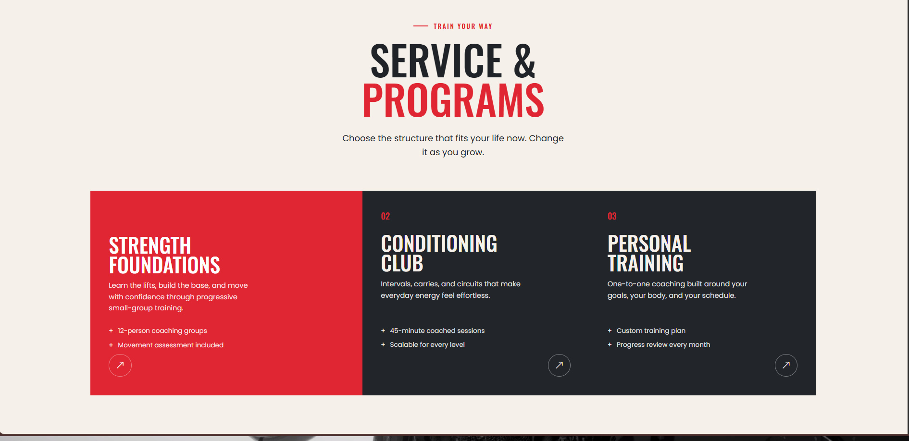
07 / SERVICES
Training programs and services
Three pathways help visitors find the kind of training that fits their goals.
01 STRENGTH FOUNDATIONS
Lifting fundamentals and confidence through small-group training.
02 CONDITIONING CLUB
Intervals, carries and circuits designed to build everyday energy.
03 PERSONAL TRAINING
One-to-one coaching, a custom plan and regular progress reviews.
Programs page — actual website screenshot.
VOLT GYM / ASTGEN SOFTWARES LLP
08 / 25

Slide 9
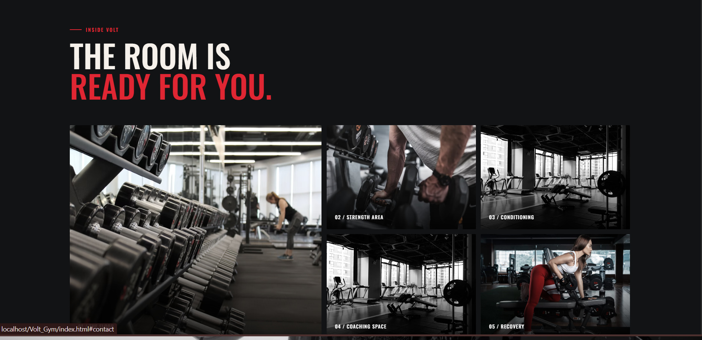
08 / VISUAL EXPLORATION
Inside Volt: the training gallery
VISUAL TOUR
A gallery of equipment, strength areas and conditioning spaces.
SELECTABLE IMAGES
Visitors can open selected photos in a larger lightbox view.
VISUAL HIERARCHY
One large feature image is balanced by smaller supporting tiles.
PURPOSE
Photography helps visitors picture the environment before they arrive.
Gallery section with the original browser frame cropped away.
VOLT GYM / ASTGEN SOFTWARES LLP
09 / 25

Slide 10
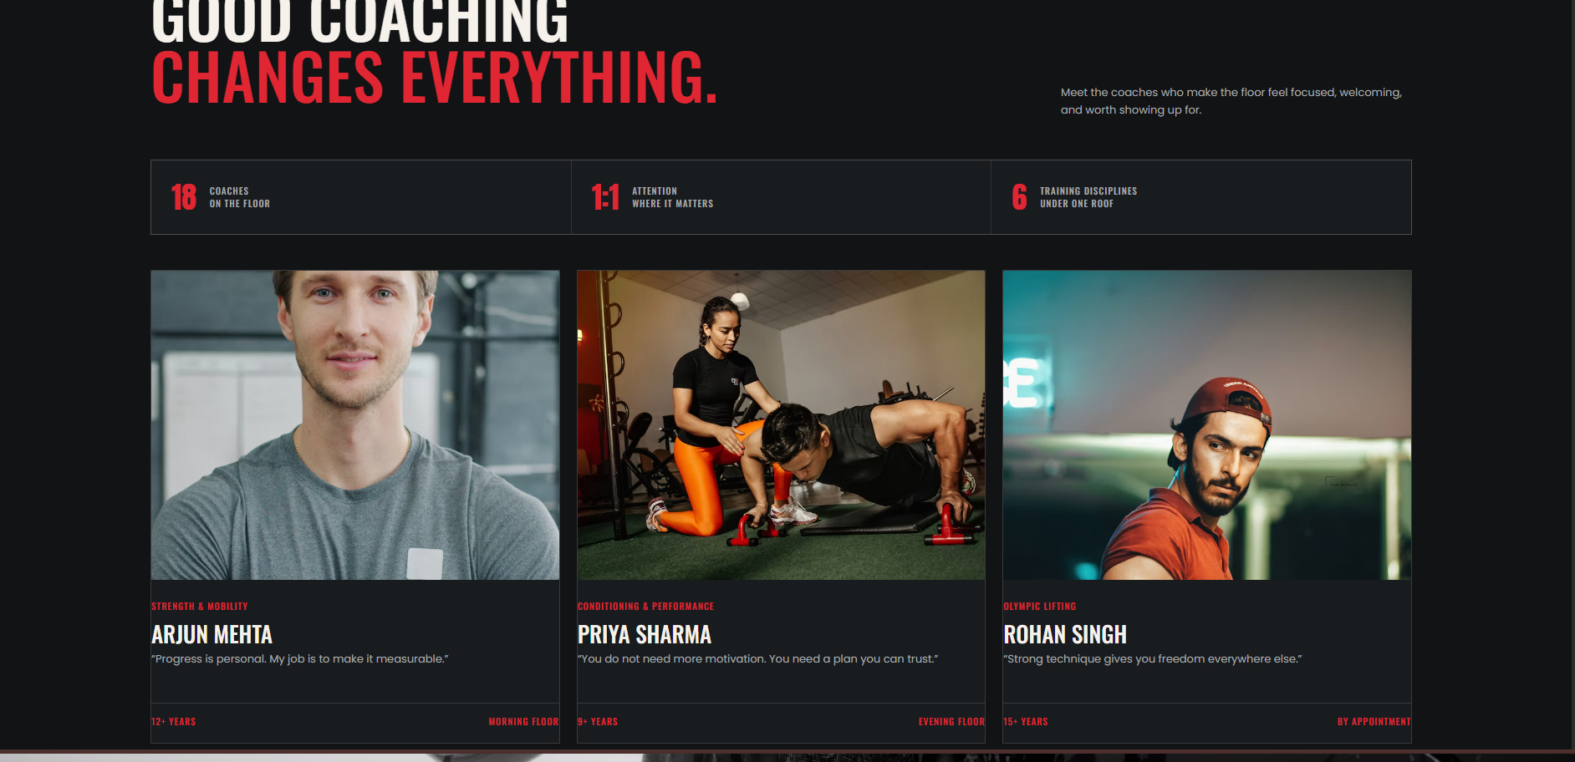
09 / PEOPLE
Coach and trainer profiles
SPECIALISATIONS
Profiles highlight the coaching discipline and trainer identity.
EXPERIENCE LABELS
Years of experience and short quotes add context.
TRUST & CLARITY
The section helps prospective members understand the coaching offer.
SCOPE NOTE
Profiles are presentation content; there is no staff-management module.
Trainer cards as displayed on the public site.
VOLT GYM / ASTGEN SOFTWARES LLP
10 / 25

Slide 11
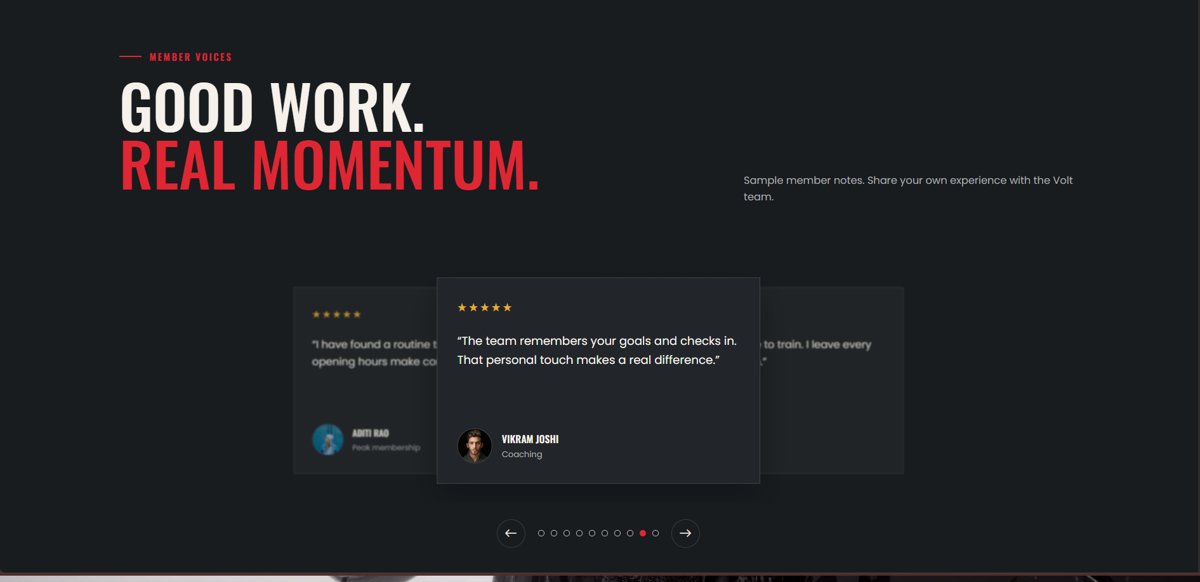
10 / COMMUNITY
Member reviews and feedback
TESTIMONIAL CAROUSEL
Previous/next controls and pagination navigate member quotes.
REVIEW FORM
Collects a name, a 1–5 star rating and written feedback.
OPTIONAL CONTACT
Email and phone fields are optional individually; backend requires a contact method.
PERSISTENCE
Accepted reviews are stored for staff review.
Member review experience.
VOLT GYM / ASTGEN SOFTWARES LLP
11 / 25

Slide 12
11 / PLANS & PRICING
Membership plans at a glance
ESSENTIAL
PEAK
PERSONAL
₹1,000
₹1,500
₹3,000
/ month
/ month
/ month
+
Full gym access, 06:00–22:00
+
24/7 full gym access
+
Everything in Peak
+
Changing rooms and recovery area
+
4 coached classes each month
+
4 personal training sessions
+
Monthly movement check-in
+
Quarterly goal-setting session
+
Custom training program
Prices and benefits reflect the current website interface; payment processing is not implemented.
VOLT GYM / ASTGEN SOFTWARES LLP
12 / 25

Slide 13
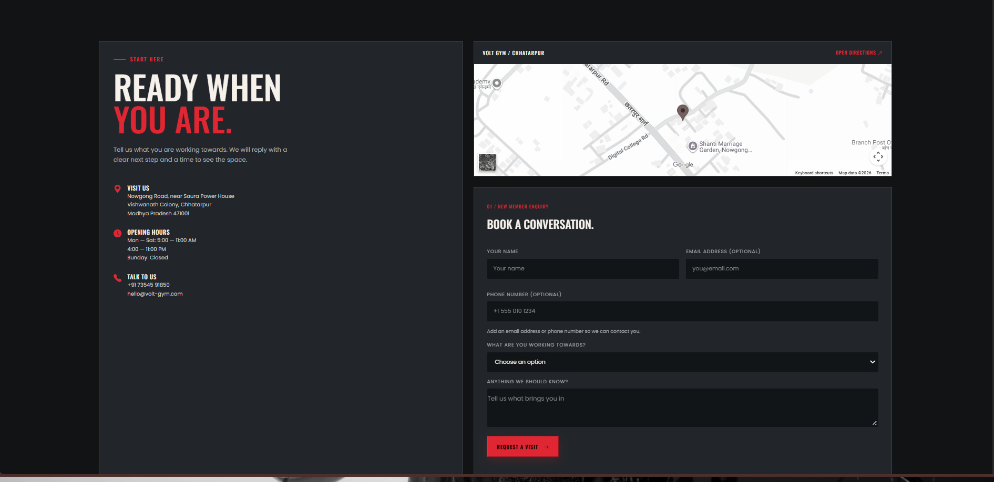
12 / LEAD CAPTURE
Contact and visit enquiry
CONTACT DETAILS
Address, opening hours, phone and email are shown together.
LOCATION
An embedded map helps visitors find the gym.
ENQUIRY FIELDS
Name, email or phone, training goal and an optional message.
SUBMISSION FLOW
The form sends a request to the PHP API for validation and storage.
Contact section and visit request form.
VOLT GYM / ASTGEN SOFTWARES LLP
13 / 25

Slide 14
13 / USER EXPERIENCE
Responsive UI and interaction design
NAVIGATION
THEME
CAROUSELS
GALLERY
Section links and responsive mobile navigation.
Light/dark toggle with saved preference.
Hero and review controls with pagination.
Selectable images and lightbox behaviour.
Usability details
ACCESSIBILITY
Controls include descriptive labels where appropriate.
MOTION
Reduced-motion preferences are considered in the stylesheet.
CONSISTENCY
Buttons, cards, spacing and colours follow a shared design system.
VOLT GYM / ASTGEN SOFTWARES LLP
14 / 25

Slide 15
14 / IMPLEMENTATION
Technology stack
HTML5
CSS3
VANILLA JS
BOOTSTRAP
Semantic structure and content
Responsive layout, themes and visual effects
Carousel, lightbox, theme and form interactions
CSS utilities and Bootstrap Icons
PHP
MYSQL + PDO
XAMPP
GITHUB ACTIONS
API request handling and admin dashboard
Persistent storage and prepared queries
Local Apache, PHP and MySQL environment
Static-site deployment workflow
No frontend compilation step is required for the public website.
VOLT GYM / ASTGEN SOFTWARES LLP
15 / 25

Slide 16
15 / SYSTEM ARCHITECTURE
How the system components connect
01
02
03
04
VISITOR BROWSER
→
PHP API
→
MYSQL DATABASE
→
ADMIN PANEL
HTML · CSS · JavaScript
api.php · validation
volt_gym schema
admin.php · session
WRITE
READ / UPDATE STATUS
PUBLIC FORM SUBMISSION
STAFF INBOX
Browser sends JSON to PHP; valid records are stored in MySQL.
Admin reads saved records and marks submissions as read.
VOLT GYM / ASTGEN SOFTWARES LLP
16 / 25

Slide 17
16 / FRONTEND IMPLEMENTATION
Source code map
Volt_Gym/
├── index.html Main public website
├── assets/
│ ├── css/ Stylesheets and Bootstrap CSS
│ ├── js/ Frontend interactions
│ ├── image/ Logos, portraits and photography
│ └── font/ Local font assets
└── php/
├── api.php Form submission API
├── admin.php Admin dashboard
├── config.php Database configuration
└── schema.sql Database schema
PUBLIC LAYER
HTML, CSS and JavaScript run directly in the browser.
SERVER LAYER
PHP endpoints process requests and connect to MySQL.
DEPLOYMENT NOTE
GitHub Pages can host static files, but it cannot execute PHP.
VOLT GYM / ASTGEN SOFTWARES LLP
17 / 25

Slide 18
17 / PHP WORKFLOW
Backend and form processing
01
02
03
04
REQUEST
→
VALIDATE
→
PERSIST
→
RESPOND
POST JSON payload
Required fields and formats
Prepared SQL insert
HTTP status + message
api.php
config.php
DATABASE WRITE
Handles review and enquiry POST requests; returns validation errors or success responses.
Builds the PDO database connection from environment variables or local defaults.
Accepted submissions are inserted with prepared SQL statements.
VOLT GYM / ASTGEN SOFTWARES LLP
18 / 25

Slide 19
18 / MYSQL SCHEMA
Database design
inquiries
reviews
admins
admin_read_status
id · name · email · phone
goal · message · created_at
id · name · email · phone
rating · message · created_at
id · username
password_hash · created_at
submission_type · submission_id
read_at
SCHEMA NOTES
DATABASE
volt_gym · utf8mb4 character set.
VALIDATION
Review ratings are constrained to 1–5 stars.
ADMIN ACCOUNTS
Unique usernames; passwords stored as hashes.
READ STATE
Submission type and ID identify read-status records.
VOLT GYM / ASTGEN SOFTWARES LLP
19 / 25

Slide 20
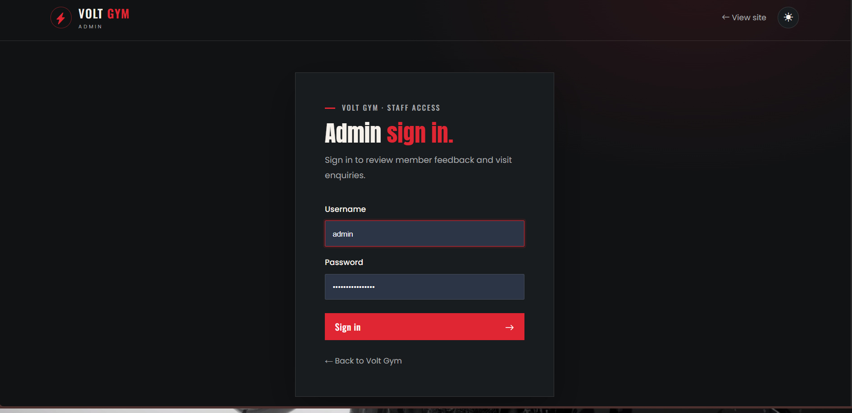
19 / ACCESS CONTROL
Admin authentication and safeguards
ACCOUNT CREATION
create_admin.php is CLI-only and hashes the chosen password.
SIGN-IN
Admin login verifies credentials against the stored password hash.
SESSION
Session-based authentication protects dashboard actions.
CSRF PROTECTION
Admin POST actions include a server-validated session token.
SAFER DEFAULTS
Session-cookie settings and response headers add protection.
Staff-only sign-in page.
VOLT GYM / ASTGEN SOFTWARES LLP
20 / 25

Slide 21
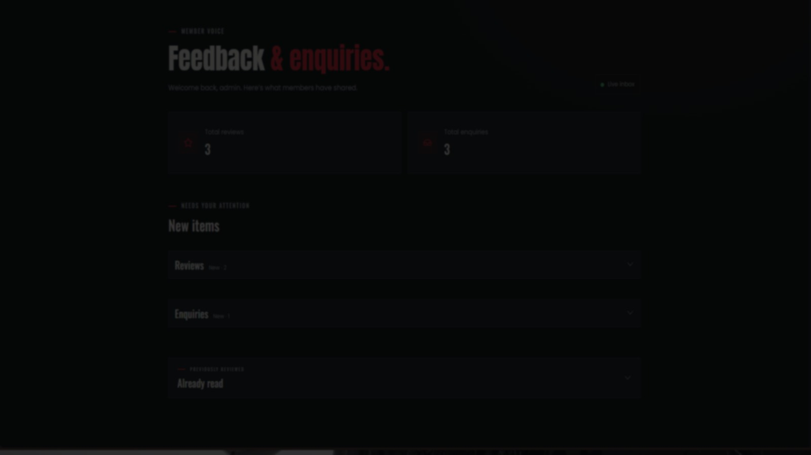
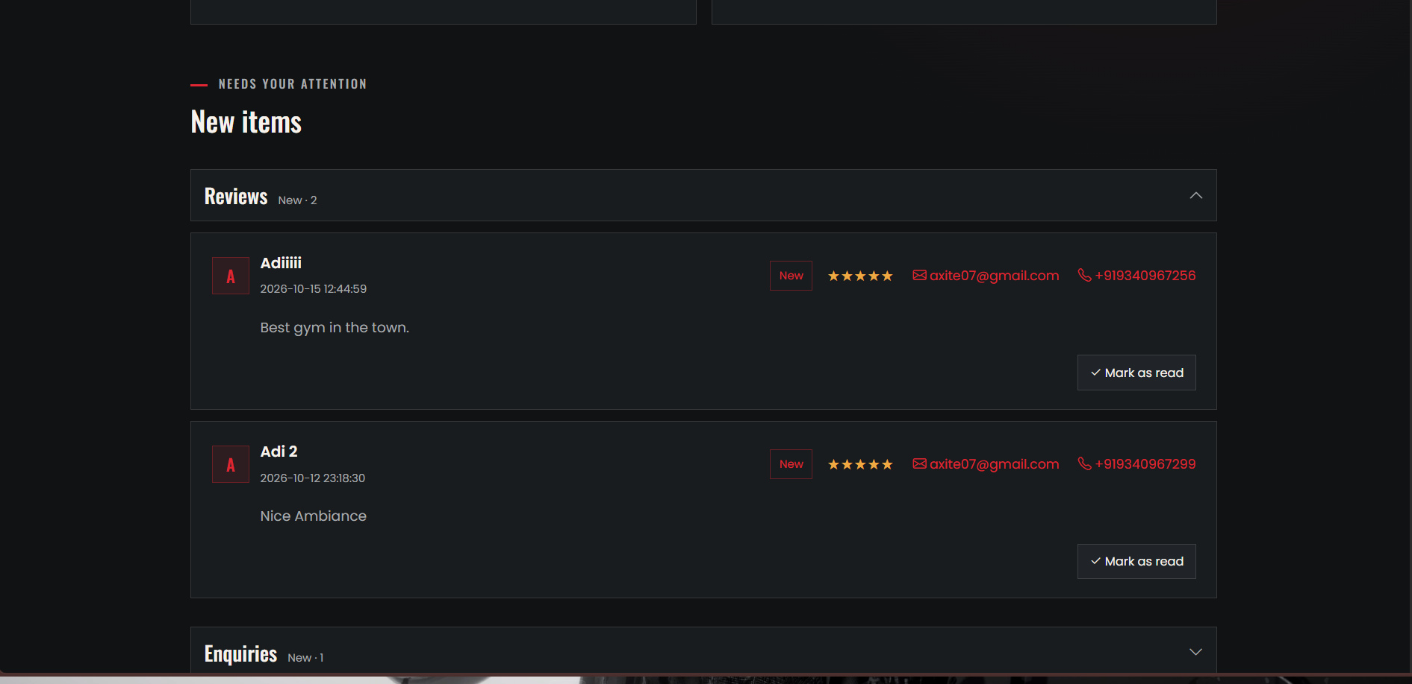
20 / SUBMISSION MANAGEMENT
Admin dashboard and submission inbox
ONE STAFF-ONLY VIEW
Feedback &
enquiries.
OVERVIEW
Total review and enquiry counts.
NEW ITEMS
Incoming submissions grouped for attention.
READ STATUS
Admin inbox displaying submitted reviews and enquiries.
Mark items as read and keep track of reviewed records.
VOLT GYM / ASTGEN SOFTWARES LLP
21 / 25

Slide 22
21 / QUALITY CONSIDERATIONS
Validation, security and testing
INPUT VALIDATION
DATABASE SAFETY
ADMIN SAFETY
Name, contact method, email/phone formats, rating range and message length.
PDO prepared statements and exception-based database error handling.
Password hashing, session checks, CSRF validation and output escaping.
PRE-SUBMISSION TEST CHECKLIST
Submit a valid enquiry and confirm it appears in the admin inbox.
Submit a valid review and verify its rating and text.
Try invalid contact details and out-of-range ratings.
Sign out and verify the dashboard cannot be accessed directly.
VOLT GYM / ASTGEN SOFTWARES LLP
22 / 25

Slide 23
22 / SETUP & DEPLOYMENT
Run the project locally
LOCAL FULL-STACK SETUP
STATIC PREVIEW
GitHub Actions deploys the static frontend to GitHub Pages.
01
Place the project in C:\xampp\htdocs\Volt_Gym
02
Start Apache and MySQL in XAMPP
03
Import php/schema.sql using phpMyAdmin
IMPORTANT LIMITATION
04
Open http://localhost/Volt_Gym/
GitHub Pages does not execute PHP; form persistence requires a PHP-capable server and MySQL.
05
Create an admin account with php/create_admin.php
06
Sign in at /php/admin.php
Use local XAMPP to demonstrate the full-stack form and admin workflows.
VOLT GYM / ASTGEN SOFTWARES LLP
23 / 25

Slide 24
23 / CONCLUSION
What the project delivers — and what comes next
CURRENT DELIVERABLE
POSSIBLE NEXT ITERATIONS
BRANDED WEBSITE
MEMBERSHIP
Responsive gym information site with interactive sections.
Real registration and online payment integration.
MEMBER ENGAGEMENT
MEMBER PORTAL
Programs, gallery, trainer, review and membership pages.
Accounts, attendance and progress tracking.
FULL-STACK WORKFLOW
CONTENT MANAGEMENT
PHP/MySQL handling for enquiries and reviews.
Admin tools to update plans and website content.
STAFF TOOLING
PRODUCTION HOSTING
Protected inbox with submission read-status management.
Deploy PHP backend and database on a secure server.
VOLT GYM / ASTGEN SOFTWARES LLP
24 / 25

Slide 25
VOLT GYM / ASTGEN SOFTWARES LLP
THANK
YOU.
Thank you for your time and consideration.
Full Stack Development Internship Project
DEVELOPED BY
Aditya Shukla · 0614CS231004 / Dileep Rathore · 0614CS231016
4th Year · Computer Science Department
THANK YOU
Pt. Devprabhakar Shastri College of Technology
25 / 25
GUIDE Ajay Prajapati · HOD Santosh Patel

